Slide 1
Full-Stack Web Development Lecture 6: API security and scalable architectures Ashley Williams Ashley.Williams@mmu.ac.uk

Slide 2
Learning Objectives
To understand:
some of the steps we can take towards securing an API
some of the steps we can take toward making our applications scalable

Slide 3
Unit Overview
# | W/C | Lecture | Lab
1 | 03/10/2022 | Introduction to Full-Stack | Recap/RESTful APIs
2 | 10/10/2022 | Introduction to NodeJS/ExpressJS | Getting started with NodeJS/ExpressJS
3 | 17/10/2022 | Interacting with Databases | Interacting with Databases
4 | 24/10/2022 | Handling Authentication | Handling Authentication
5 | 31/10/2022 | Version Control | Assignment Support: Backend
6 | 07/11/2022 | API Security and Scaling | Assignment Support: Backend
7 | 14/11/2022 | Introduction to VueJS | VueJS Basics
8 | 21/11/2022 | Style, Layout, and Navigation | Layout and Navigation
9 | 28/11/2022 | Networking | Handling API requests
10 | 05/12/2022 | Structuring and Refactoring | Assignment Support: Front-end
11 | 12/12/2022 | Code Quality | Assignment Support: Front-end

Slide 4
API first development
Many practitioners now advocate ‘API-first development.’
Design and create the API first.
Allows developers to focus from the start on how the overall application will be structured and the scope of its functionality
Both front-end and back-end teams can begin to work on the project with a clear understanding of how the server and client will communicate.
Security is planned and integrated from the outset.
Backend
API
Frontend

Slide 5
API first development
Defining the API means knowing how the applications processes will work together. It becomes a tool for finding design flaws early in the development process.
Self-documenting (e.g. Swagger)
Aids backend database design by visualising the structure of the required data
Fits naturally with agile development. Once the API is defined, developers can work iteratively on features in the order of priority

Slide 6
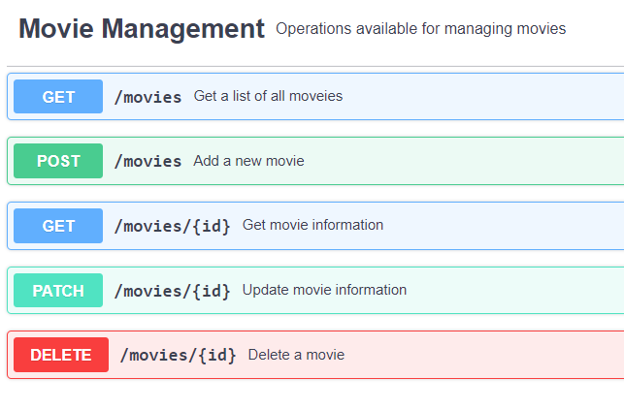
Remember the MoviesDB server?
Well since we deployed it, it’s blown up. Millions of people are using it every day and the servers are struggling to keep up.
We need to think about scaling and security!
(preferably before it has gotten to this point)

Slide 7
What do we want to achieve?
We want to secure our API so that those pesky hackers can’t misuse our data
We want the application to be scalable so that we can handle the traffic after we release it and all of the IMDB users start using our application instead
Both, API security and building scalable web applications could be their own degree course – so we will just look at a few key concepts on each.

Slide 8
API security concepts
Some general steps you can take for securing an API:
Use tokens for identification (e.g. API keys, authorisation)*
Use an API gateway*
Implement encryption and signatures (e.g. HTTPS)
Test, sniff, hack, understand you application to identify vulnerabilities
Use quotas and throttling to avoid DDoS attacks – implement logging*

Slide 9
Tokens/API Keys
Usually used as a unique identifier of an external entity requesting access to your application
Applications
Users
Developers/other applications
Why?
Enhanced security
Enable throttling/quotas
See where your traffic is coming from? Are specific users using specific parts of the app?

Slide 10
Tokens/API Keys: The assignment server
When a user logs in, the server verifies the email and password.
If everything is good, then the server generates a random string of characters
The string is saved to the DB and sent to the user
Future requests requiring authentication check the request headers for the X-Authorization token, and that the token appears in the DB.
Problems:
The user is logged in forever, no timeouts
The user can manipulate the token. With no logging and throttling, you can brute force the tokens until you find a valid, logged in user.

Slide 11
Tokens/API Keys: JWT tokens
JSON Web Tokens (JWT) can help with this
JWT tokens are created using some secret string that only the server knows about, meaning that they can’t be manipulated by the client
JWT tokens can also be set to expire after a period of time, forcing the client to login again before continuing
http://jwt.io has more information, and can be used to display the contents of a JWT token
Demo: MovieDB with authentication (v3 directory)
Creating the JWT token on login
The auth middleware to lockdown endpoints
The token timing out

Slide 12
API security concepts
Some general steps you can take for securing an API:
Use tokens for identification (e.g. API keys, authorisation)*
Use an API gateway*
Implement encryption and signatures (e.g. HTTPS)
Test, sniff, hack, understand you application to identify vulnerabilities
Use quotas and throttling to avoid DDoS attacks – implement logging*

Slide 13
API Gateway
Sits between the client and a collection of backend services
Route requests to the relevant service, sometimes multiple services
Single point of entry for registering HTTPS
Allows you to implement quotas and throttling in one place*
Allows you to implement logging in one place*
Allows you to implement billing for API requests in one place
As you add new services and remove older services, the clients still see a consistent point of entry
Allows you to implement load balancing when scaling*
API
Gateway
S1
S2
Sx
DB

Slide 14
Before we go any further, a word on architectures….
Traditionally, our entire application has been kept in a single codebase. We call this a monolithic architecture. (e.g. the assignment server code)
Scaling monoliths means replicating the entire application on multiple servers, using either a single database, or handling the sharding of data.
Monoliths often work just fine. However, as the code base grows, they get more difficult to manage, changes are more likely to break different parts of the application, and more stakeholders get frustrated.

Slide 15
Before we go any further, a word on architectures….
These frustrations led to the increase in popularity of the microservices architecture.
Applications are built as a suite of services
Services are independently deployable and scalable
Each service has a firm boundary, and can even be written using different technologies.
They can also be managed by different teams.

Slide 16
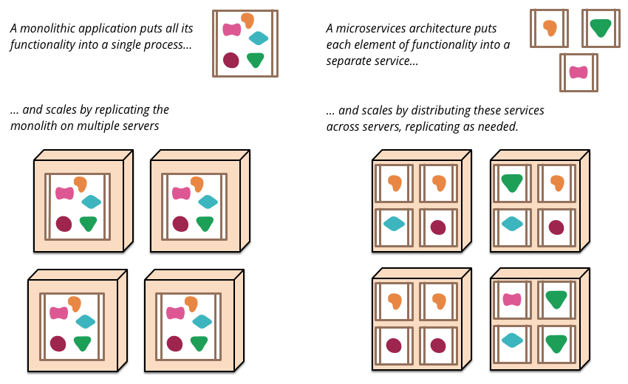
Before we go any further, a word on architectures….

Slide 17
Who uses Microservices?
Uber: https://eng.uber.com/service-oriented-architecture/
Netflix: https://www.youtube.com/watch?v=CZ3wIuvmHeM
Amazon: http://highscalability.com/amazon-architecture
Ebay
SoundCloud: https://developers.soundcloud.com/blog/building-products-at-soundcloud-part-2-breaking-the-monolith
Groupon
Monzo
Many more...
Massively popular, but a big initial overhead – means that companies tend to try the monolith first and then move to microservices when they have to

Slide 18
Why am I now talking about Microservices?
Implementing an API gateway as a separate application means that we have two services:
The API gateway
The movieDB
We could also split out our movie DB functionality from our user management functionality…but let’s not for now.
We can use the API gateway to run multiple instances of the movieDB and load balance requests between them = a scalable application!

Slide 19
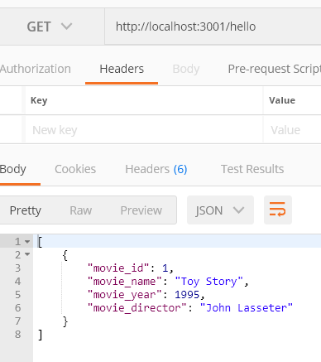
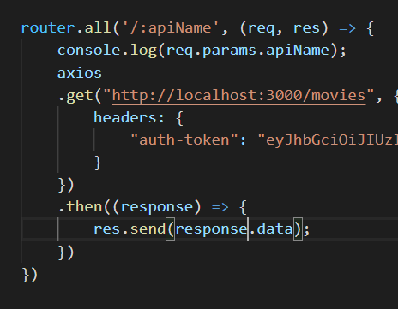
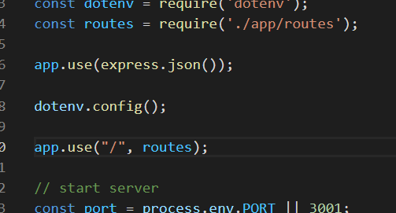
Implementing a basic API gateway
Create a new project – give the same starter code for initialising express
Create a forwarder

Slide 20
Implementing a basic API gateway
Create a new project – give the same starter code for initialising express
Create a forwarder

Slide 21
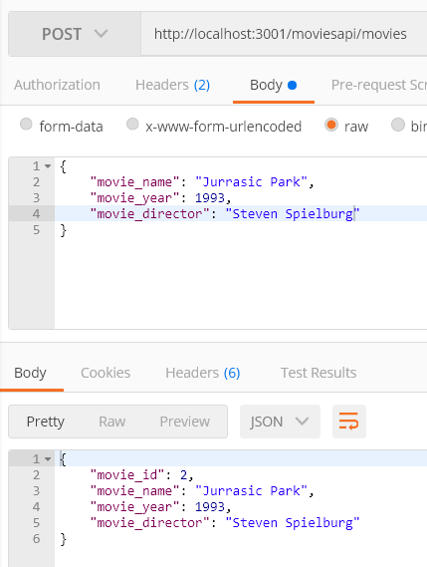
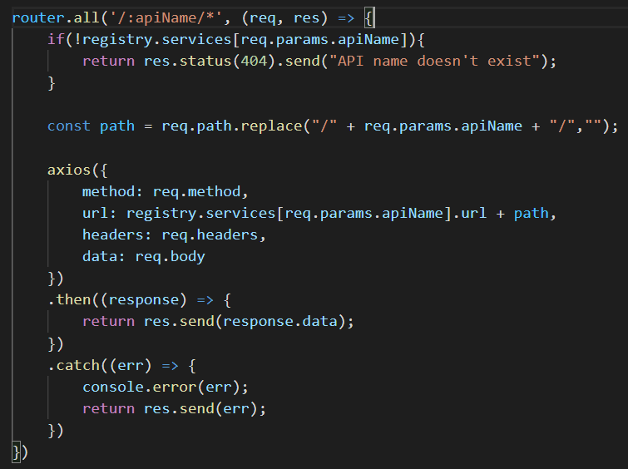
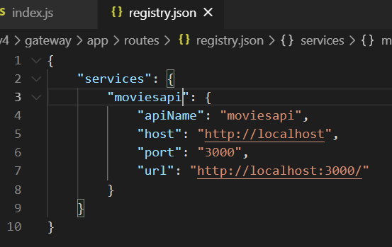
Create a registry for routing requests to different services

Slide 22
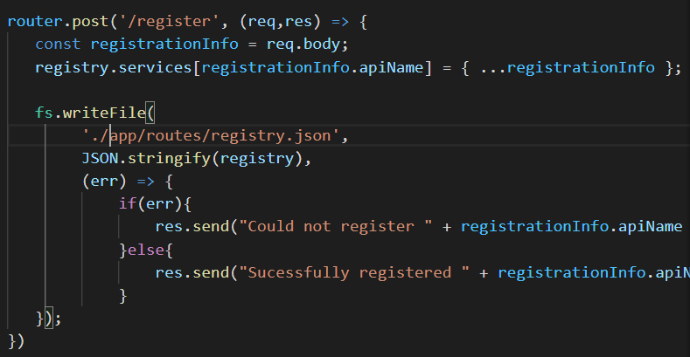
Allow services to register themselves
If we manage the API gateway service, we generally don’t want to be maintaining a list of all other services manually (think Netflix with 100’s of services that are always changing)
So, let’s allow services to register themselves with our gateway too.

Slide 23
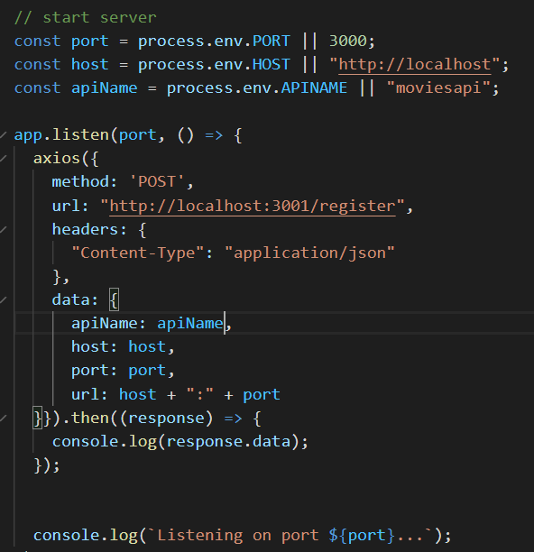
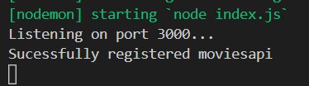
Make the service register itself on start
In the app.listen of the moviesDB service, send a request to register the services

Slide 24
Scaling the application
We want to be able to scale the application
To do this we want to be able to run multiple instances of each service and then share requests across the multiple instances
So let’s break the task down into two parts:
The ability to register multiple instances of a service
A method for sharing requests between instances

Slide 25
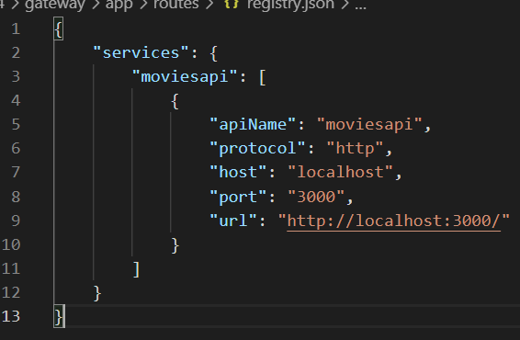
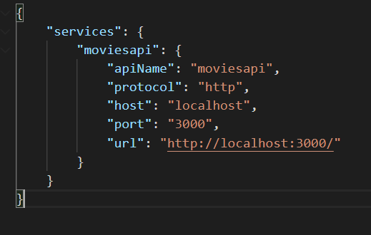
Scaling the application: Multiple instances of a service
We want to change the format of our registry file, so that it handles a list of instances

Slide 26
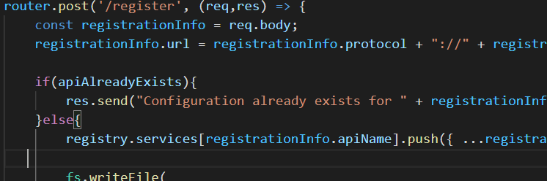
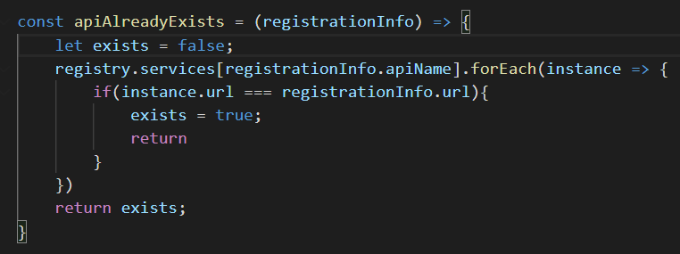
Scaling the application: Multiple instances of a service
Register now adds the config to the list if it doesn’t already exist

Slide 27
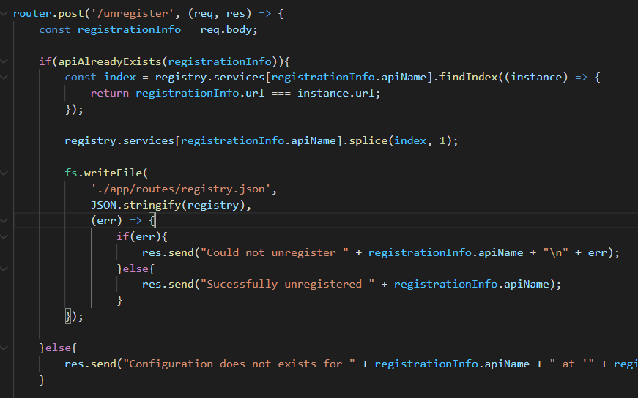
Scaling the application: Multiple instances of a service
We also need to be able to remove instances from the list
We could write a service which periodically sends requests to our list of instances, and then unregisters any that return a 404. (not today though)

Slide 28
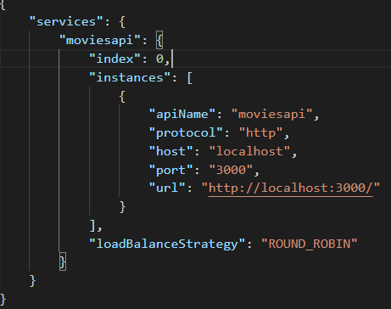
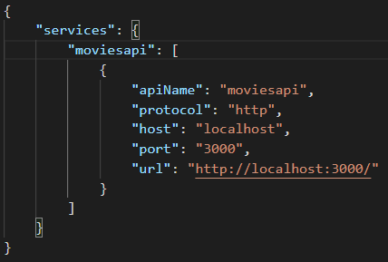
Scaling the application: Load balancing between multiple instances
Once again, we want to change the structure of our registry.json file

Slide 29
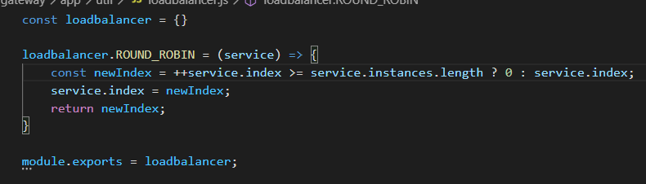
Scaling the application: Load balancing between multiple instances
Create a file for implementing the load balance logic
Our round robin balancer will pass requests to each instance in our list in turn
The ROUND_ROBIN function increments the index and returns, resetting to zero once we’ve hit the last instance

Slide 30
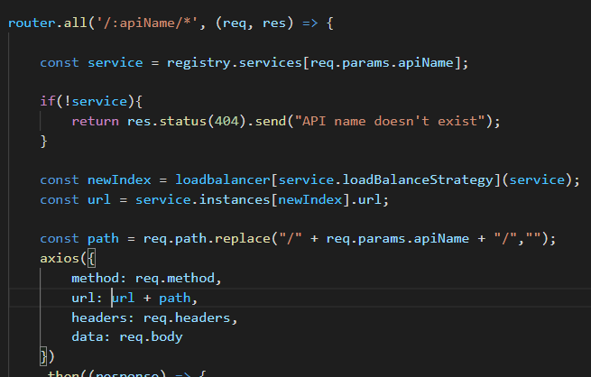
Scaling the application: Load balancing between multiple instances
Now send the incoming request to the instance with the next index using the ROUND_ROBIN function.

Slide 31
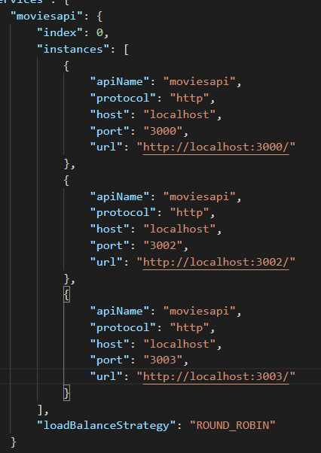
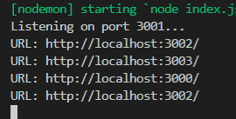
Scaling the application: Load balancing between multiple instances
To test, add some dummy instances and send the same request
We log the URL to the console to check

Slide 32
API security concepts
Some general steps you can take for securing an API:
Use tokens for identification (e.g. API keys, authorisation)*
Use an API gateway*
Implement encryption and signatures (e.g. HTTPS)
Test, sniff, hack, understand you application to identify vulnerabilities
Use quotas and throttling to avoid DDoS attacks – implement logging*

Slide 33
API Gateway
Sits between the client and a collection of backend services
Routes requests to the relevant service, sometimes multiple services
Single point of entry for registering HTTPS
Allows you to implement quotas and throttling in one place*
Allows you to implement logging in one place*
Allows you to implement billing for API requests in one place
As you add new services and remove older services, the clients still see a consistent point of entry
Allows you to implement load balancing when scaling*

Slide 34
API Gateway
Sits between the client and a collection of backend services
Routes requests to the relevant service, sometimes multiple services
Single point of entry for registering HTTPS
Allows you to implement quotas and throttling in one place*
Allows you to implement logging in one place*
Allows you to implement billing for API requests in one place
As you add new services and remove older services, the clients still see a consistent point of entry
Allows you to implement load balancing when scaling*

Slide 35
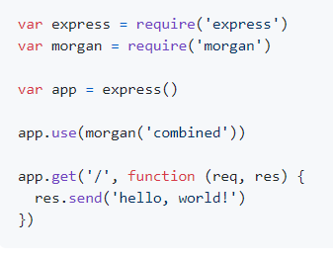
Logging Requests
There’s a library for that…
Morgan allows us to log content in express applications
There are a lot of ways that you can tailor morgan to your specific needs, but it also works straight out of the box
The assignment code uses morgan to print to console

Slide 36
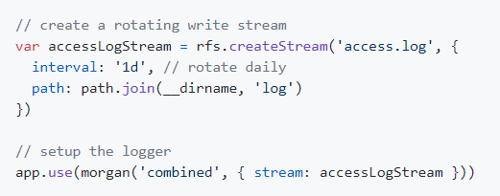
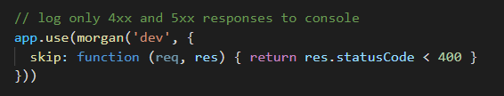
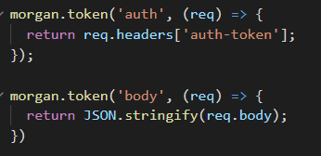
Logging Requests
We’ll make a couple of changes so that we:
log to a file each day,
display errors in the console,
and add a bit of additional information

Slide 37
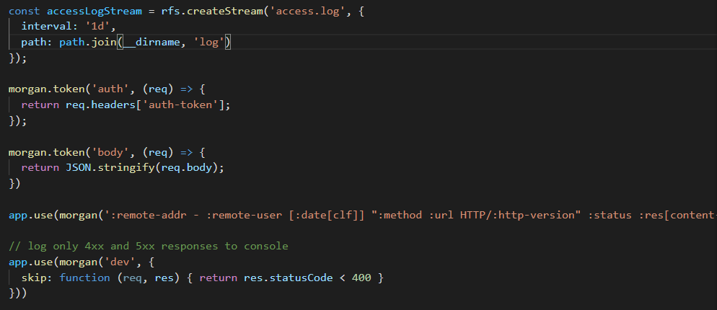
Logging Requests

Slide 38
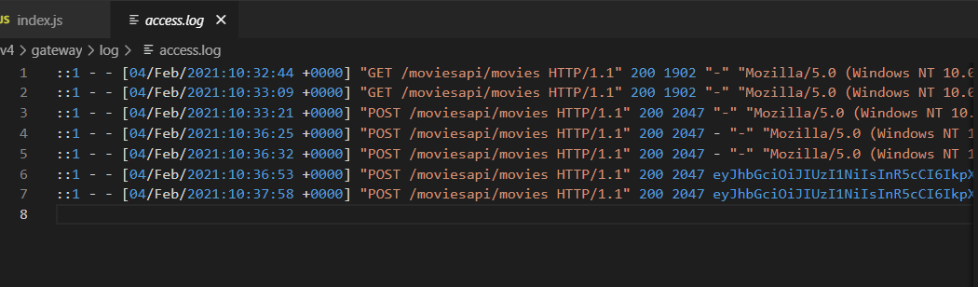
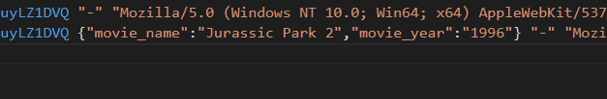
Logging Requests

Slide 39
API Gateway
Sits between the client and a collection of backend services
Routes requests to the relevant service, sometimes multiple services
Single point of entry for registering HTTPS
Allows you to implement quotas and throttling in one place*
Allows you to implement logging in one place*
Allows you to implement billing for API requests in one place
As you add new services and remove older services, the clients still see a consistent point of entry
Allows you to implement load balancing when scaling*

Slide 40
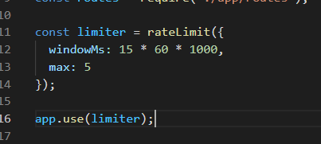
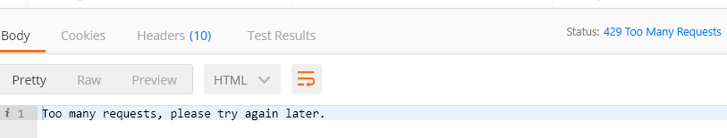
Quotas and throttling
Again, there’s a library for that… express-rate-limit

Slide 41
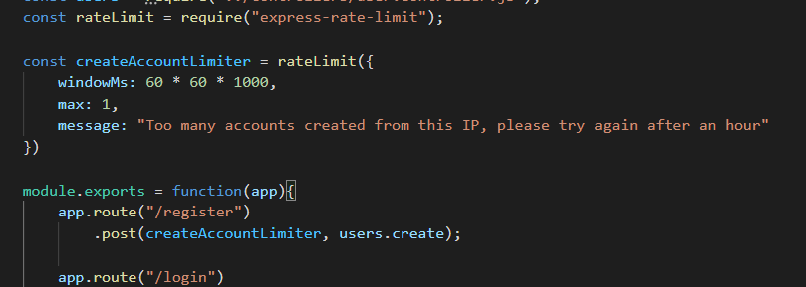
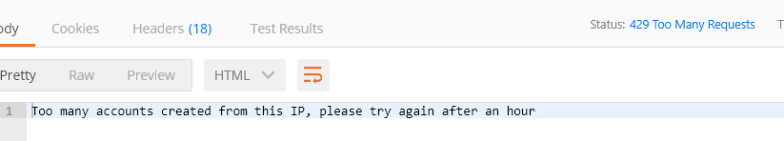
Quotas and throttling: Block specific actions
Block specific actions in the service
Note that this is per instance

Slide 42
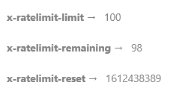
Quotas and throttling: Block specific actions
Express-rate-limit defaults to using your IP as the key (req.ip)
However, you can set it to use an API key if you wanted to throttle access to a particular application/group
Get the client to send their API key in the headers? (req.headers)
The limits/quotas/remaining requests are stored as headers. However, the library also allows you to hook up your limits/quotes to some store (e.g. Mongo)
There are options to up quotas for specific users (e.g., if they buy more API requests)

Slide 43
API Gateway
Sits between the client and a collection of backend services
Routes requests to the relevant service, sometimes multiple services
Single point of entry for registering HTTPS
Allows you to implement quotas and throttling in one place*
Allows you to implement logging in one place*
Allows you to implement billing for API requests in one place
As you add new services and remove older services, the clients still see a consistent point of entry
Allows you to implement load balancing when scaling*

Slide 44
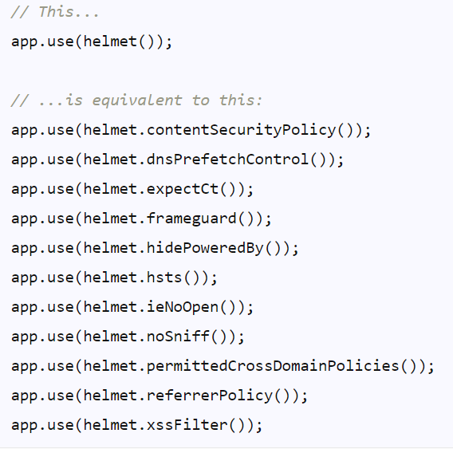
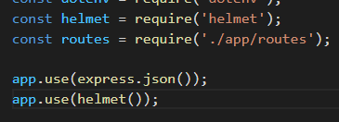
Additional security: helmet
There are a lot of pre-existing libraries for adding security to express.
Helmet is one library that auto protects against a variety of common security flaws.

Slide 45
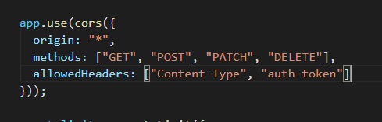
Additional security: cors
Cross-Origin Resource Sharing
“an HTTP-header based mechanism that allows a server to indicate any other origins (domain, scheme, or port) than its own from which a browser should permit loading of resources.”
Allow requests from anyone
Only allow certain methods/headers

Slide 46
Repo
The code for this talk is available for anyone interested:
https://github.com/ash-williams/MAD_microservices

Slide 47
Optional advanced exercises based on this week’s lecture
If you are interested and wanted to play around with the codebase, you could try:
Splitting out the movies and user management services, how would the movies service know that you are authenticated? (moderate)
Implement a new load balancer function which outperforms the ROUND_ROBIN (moderate)
Implement databases for the movies service, the user service and the gateway (moderate)
Throttle based on a stored API key – allow users to have different allowanced (based on how much money they pay us) (difficult)
Find a vulnerability, write a fix, submit a pull request (difficult – maybe not?)
Choose one of my final year projects, or do a masters after you graduate and choose one of my MSc projects ☺
Build a SaaS, become a millionaire, pay me lots of money to come and work for you…

Slide 48
This week’s lab
In this week's lab, you will:
Finish your assignment backend application
Assignment Checklist:
Implement version control for your assignment (optional)
Implement extension task 1

Slide 49
Questions?

Slide 50
Sources
https://martinfowler.com/articles/microservices.html
Channel for creating the API Gateway:
https://www.youtube.com/channel/UCNb7FvgdoLhe0GCoLCZ5z0Q
This guy should have a lot more views then he does!

